Slide 1
Solution Accelerator: Build your own AI Copilot for FSI with PostgreSQL

Slide 2

Coaches
<coaches name> - Lead Coach
<coaches name> - Coach
© 2025 Microsoft. All rights reserved.
Notes:
<Coach>
Introduce yourself and mention your title and expertise about this topic.​
If there is more than one Coach, invite the other Coaches to provide a short introduction.

Slide 3


What this workshop includes
This workshop includes:
This workshop does not include:
Labs.
Peer-to-peer proven practices sharing.
Safe place to practice.
Shared hands-on exercise environment (aka OpenHack).
© 2025 Microsoft. All rights reserved.
February 2025

Slide 4


To have the best experience
Prepare your technology
Engage and actively participate
Stay don't leave the workshop more than 15 minutes
Ask questions
Respond to questions
Share your experiences
Return on-time after each break
Maximize your practice time
Help each session to be successful
© 2025 Microsoft. All rights reserved.
Notes:
<Coach>
Speaker notes:
Here are some housekeeping/ground rules:​
First, please silence your phones or other devices.​
Please show your face on camera when working in teams – especially when you are speaking.
If you have bandwidth issues, please let me know (that’s the only exception for being off camera)​. Being on camera especially when asking a question or sharing a point encourages everyone to focus on the speaker and elevates the energy in the session as if in a face-to-face conversation.
Prepare your surroundings so you can focus on the training.​
Actively participate and ask questions.​
Practice inclusivity: Let every voice on your team be heard.​
Mute your microphone when you are not speaking​.
Use your collaboration skills, virtually​.

Slide 5
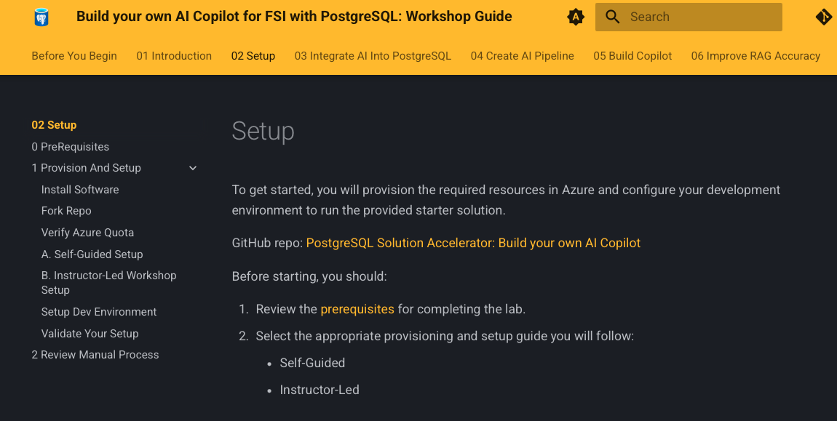
Instructor led workshop
1
Open the guide in a browser
https://../microsoft-postgresql-solution-accelerator-build-your-own-ai-copilot/02-Setup/
© 2025 Microsoft. All rights reserved.
Notes:
30 seconds
<Coach>
Encourage students to open the participant guide and follow along. They will have access to the same PPT that you are showing.

Slide 6
Workshop abstract
In this hands-on workshop you will learn how to build an AI Copilot using PostgreSQL, Azure AI, and FastAPI to process and analyze unstructured data.
You will set up the infrastructure, integrate AI capabilities like vector search and document intelligence, and develop a conversational UI.
By the end, you will have a functional AI assistant that can retrieve, summarize, and interact with data in real-time.
© 2025 Microsoft. All rights reserved.
Notes:
2 minutes
<Coach> guidance here
Say: This workshop is an opportunity to practice creating a customer conversation outline and share ideas with your peers. The Labs are an opportunity to practice using the product and demonstrating key steps.

Slide 7
Learning objectives
Set up and configure PostgreSQL with AI extensions for intelligent data retrieval.
Integrate Azure AI services to extract, summarize, and process unstructured data.
Develop a conversational AI assistant enabling real-time user interactions.
Given a Financial Services Industry scenario, you will be able to build and integrate an AI solution
© 2025 Microsoft. All rights reserved.
Notes:
2 minutes
<Coach> guidance here
Say: This workshop is an opportunity to practice creating a customer conversation outline and share ideas with your peers. The Labs are an opportunity to practice using the product and demonstrating key steps.

Slide 8
Intelligent apps are transforming many industries…
Employee Copilot
Knowledge search
Document intelligence
Personalized care
Demand forecasting
Support chatbot
Hyper personalization
Factory AI Assistant
Content generation & marketing
Energy
Healthcare
Visual inspection & anomaly detection
Retail associate Copilot
Field service Copilot
Retail
Manufacturing
Document processing
Customer agent Copilot
Fraud detection
Customer call summary
Wealth advisor
Financial Services
Telecommunications
Support chatbot
Notes:
1 minute
Coach guidance
Speaker notes
All these capabilities can be leveraged across industries to bring to life many different use cases that drive success.
Whether through the creation of unique chatbot experiences that help customers find information they need, identifying and summarizing key data to help employees be more productive, or analyzing large quantities of data to isolate potential risks, intelligent apps help companies create value and gain competitive advantage…
The animation highlights that this Solution Accelerator is focusing on the Financial Services Industry (FSI)

Slide 9
Standardized AI technical patterns
Document processing and summarization:
Chat with your data:
Build your own copilot
Enables users to classify, extract, summarize, and gain deeper insights from documents.
Create a conversational search experience for internal users.
Search/summarize data through a chat UI and/or task completion within the enterprise app.
Code generation and documentation:
Knowledge mining:
Content generation:
Conducts large scale knowledge mining to find information and gain valuable insights and patterns.
Summarization for app modernization and documentation generation.
Generates text or image content based on conversational user input.
Personalized recommendations:
Fraud detection:
Forecasting:
Uses machine learning algorithms to identify patterns, anomalies, or suspicious activities that may indicate fraudulent transactions or behavior.
Uses machine learning or statistics models to identify patterns and make predictions.
Applies generative AI models to present content, products, or services to individual users based on multimodal inputs from text, images, and speech, and a deep understanding of customer profiles.
Notes:
2 minutes
Coach guidance
Speaker notes
Technical patterns are made of a technical solution with repeatable architecture to solve a variety of business use cases.
This is just an introduction to the business priority and intiative. The three animations show which patterns the solution accelerator will focus on.

Slide 10
Agenda – Day one
Start | Minutes | Topic | Channel
9:00 am | 60 | Workshop overview and exercise intro​ | General
Notes:
1 minute
<Coach>
Briefly walk through the different activities in the agenda for Day 1.
Adjust the start time in the local time zone.
You will need to adjust the timing in the agenda where it makes sense, based on how things are going.
Note that there are two 10 minute breaks.
If you are running long, shorten the last discussion to let everyone out on time.
Running long will cause problems for students who have meetings following this workshop.

Slide 11
The workshop scenario
Woodgrove Bank
Notes:
15 seconds
<Coach> guidance here
Say:

Slide 12

Woodgrove Bank
Woodgrove Bank is a Financial Services company that sells a wide range of banking products and services. The bank operates in four continents and 180 countries, offering services to both public and private sectors.
Woodgrove Bank has faced several challenges with its existing Contract Management Portal.
The challenges are associated with validating contract-related documents, such as Statements of Work (SOWs) and invoices.
Traditionally, this validation process has been manual, prone to errors, and time-consuming.
Notes:
1 minute
<Coach> This is the high-level background for:
Who the customer is,
What they have now,
What they need.
Use this slide to start a discussion where the students tell you about the customer.
Say:
Take a minute to read this and tell me what you see.
Does this sound like your customers?

Slide 13
Introduction to the solution accelerator
Purpose: This accelerator demonstrates how to enhance Financial Services Industry applications by integrating AI-driven data validation, vector search, semantic ranking, and GraphRAG techniques into Azure Database for PostgreSQL.
Application Scenario: The focus is on automating the validation of financial documents, such as Statements of Work (SOWs) and invoices, to ensure accuracy and compliance.
Benefits of Implementing an AI Copilot: Implementing an AI Copilot improves productivity by automating repetitive tasks, reducing manual errors, and enhancing data-driven decision-making. It enables seamless integration of AI into business workflows, allowing organizations to optimize processes, improve accuracy, and provide intelligent assistance to users in real time.
© 2025 Microsoft. All rights reserved.
Notes:
<Coach>
Today, we'll explore how to build an AI Copilot using the Microsoft PostgreSQL Solution Accelerator. This accelerator enhances applications by integrating advanced AI capabilities into Azure Database for PostgreSQL. We will focus on a Financial Services Industry scenario, specifically automating the validation of contract-related documents like Statements of Work (SOWs) and invoices. Traditionally, this validation process is manual, prone to errors, and time-consuming. By leveraging Azure's AI services, we can automate data extraction, validation, and storage, leading to increased efficiency and accuracy. Throughout this session, we'll delve into the solution's architecture, the technologies involved, and the step-by-step process to implement your own AI Copilot. By the end, you'll have a comprehensive understanding of integrating AI into your applications to streamline operations and provide intelligent assistance to users.

Slide 14
Application Scenario
Woodgrove Bank Contract Management Application:
A web-based platform designed to automate the validation of contract-related documents, such as Statements of Work (SOWs) and invoices, in the financial services sector.
Challenges in Manual Validation:
Traditional manual processes for cross-referencing invoices with SOWs are prone to errors, time-consuming, and can lead to increased operational costs.
AI-Driven Solution:
By integrating Azure AI services and PostgreSQL extensions, the application automates data extraction and validation, ensuring faster and more accurate processing of financial documents.
© 2025 Microsoft. All rights reserved.
Notes:
<Coach>
The Woodgrove Bank Contract Management application addresses the challenges faced in the financial services industry regarding the validation of contract-related documents. Traditionally, ensuring that invoices align with Statements of Work (SOWs), especially for milestone-based payments and specific deliverables, involves manual comparison and cross-checking.
This manual process is not only meticulous but also prone to errors, leading to delays and increased operational costs. To overcome these challenges, the application leverages Azure Database for PostgreSQL - Flexible and Azure's comprehensive suite of AI services to automate and streamline the validation process. By integrating advanced AI capabilities, the application automates data extraction and validation, resulting in faster, more accurate, and cost-effective invoice validation. This approach not only enhances efficiency but also reduces the likelihood of human errors, ensuring a more reliable contract management process.

Slide 15
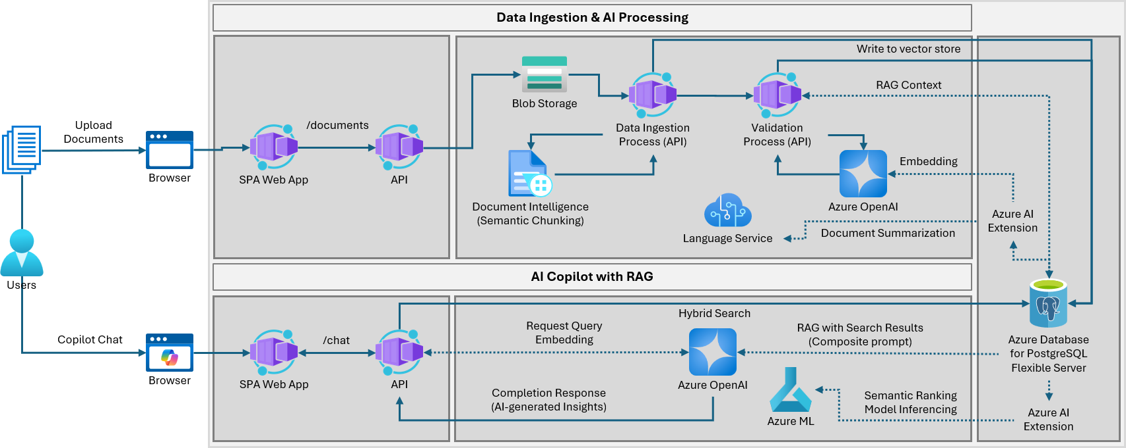
Solution Architecture
© 2025 Microsoft. All rights reserved.
Notes:
<Coach>
The Woodgrove Bank Contract Management application is designed to automate the extraction, validation, and storage of data from invoices and Statements of Work (SOWs), thereby reducing manual effort and enhancing operational efficiency. The application comprises a React-based Single Page Application (SPA) for the user interface and a backend API developed in Python using FastAPI.
This decoupled architecture offers modularity, maintainability, and scalability, allowing independent updates to the UI and backend without causing disruptions. The React frontend provides an intuitive and interactive user experience, while the FastAPI backend ensures high-performance, asynchronous request handling and data processing. Additionally, this separation enhances security by isolating sensitive data handling and authentication processes within the backend API, reducing potential vulnerabilities in the UI layer. Overall, this architecture leads to a more robust, efficient, and user-friendly application.

Slide 16
Lab outline
DAY ONE
Exercise one
Lab setup: Install software and fork the repository
Exercise two
Setup Dev Environment
Exercise three
Integrate AI into PostgreSQL
Exercise four
Create an AI-based data ingestion pipeline
Exercise five
Build the Copilot solution
© 2025 Microsoft. All rights reserved.
Notes:
<Coach>
Review with students the lab exercises that will takeNotes:
Exercise files contained in GitHub link
The initial exercise sets the stage for the other subsequent lab exercises.
It is recommended that students pay close attention to the instructions listed in detail in GitHub.​

Slide 17
Solution Concepts
Notes:
30 seconds
Coach guidance
Speaker notes
The following key concepts relate to the technical patterns and prepare the attendees to the workshop.
Python
FastAPI
React.js
Azure Database for PostgreSQL
Azure OpenAI
Azure Document Intelligence
LangChain
PostgreSQL extensions: pgvector, azureai

Slide 18
Software and Technologies
Python
FastAPI
React.js
Azure Database for PostgreSQL
Azure OpenAI
Azure Document Intelligence
LangChain
PostgreSQL extensions: pgvector, azureai
© 2025 Microsoft. All rights reserved.
Notes:
<Coach>

Slide 19
Azure Database for PostgreSQL
Solves a multitude of use cases
Open source
Proven resilience & stability
Rich feature set
Thousands of mission critical workloads
Extensible
Integration & tooling
Battle tested
Enterprise-ready
Zero data loss
Rich indexing, text search
JSONB, Geospatial (PostGIS)
Vector data support (pgvector)
AI integration (azure_ai)
© 2025 Microsoft. All rights reserved.
Notes:
<Coach>
So why is PG so popular?
Postgres is Open source which is financially palatable for many ☺
Huge community invested in building the product
Has consistent annual major releases with new functionality
This powerful functionality leads to both robustness
and the long history, 28 years, leads to stability.
So it’s battle tested and hardened
Lastly its viewed in the market as a platform to be confident in:
Some recent recognition is:
PG is continuously growing in popularity
Top in “most loved” and “wanted” by Stack Overflows survey
DBMS of the year now 2 years in a row by DB-Engines

Slide 20



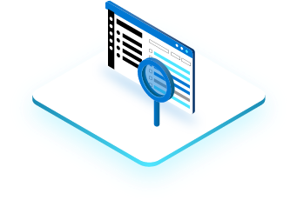
Vector Embeddings
Vector embeddings are compact, semantically-rich representations of any data
Vectors that are “close” are semantically similar
Closeness is measured by distance (cosine, dot product, Euclidean, etc.)
Easy to generate embeddings from your data via APIs (OpenAI, Hugging Face, etc.)
Answering Questions
Detecting anomalies
Making personalized recommendations
Searching for similar content
© 2025 Microsoft. All rights reserved.
Notes:
<Coach>
Vector Embeddings: data in the form of floating-point numbers that ML models and algorithms can easily use. It is a representation of the semantic meaning of a piece of text. We look at these numbers and measure the distance between them. If two text are similar, then their vector representation should be similar or close by.
How are they used:
1. They are useful in building Generative AI applications like chatbots, text generation, searching text, documents, and recommendation systems, etc.
2. Vector Search: Vector search is a method that helps you find similar items based on their data characteristics rather than by exact matches on a property field.
It works by taking the vector embeddings of your data (a table column) that you created by using a machine learning model by using an embeddings API, such as Azure OpenAI Embeddings.
It then measures the distance between the data vectors and your query vector.
The data vectors that are closest to your query vector are the ones that are found to be most similar semantically.

Slide 21
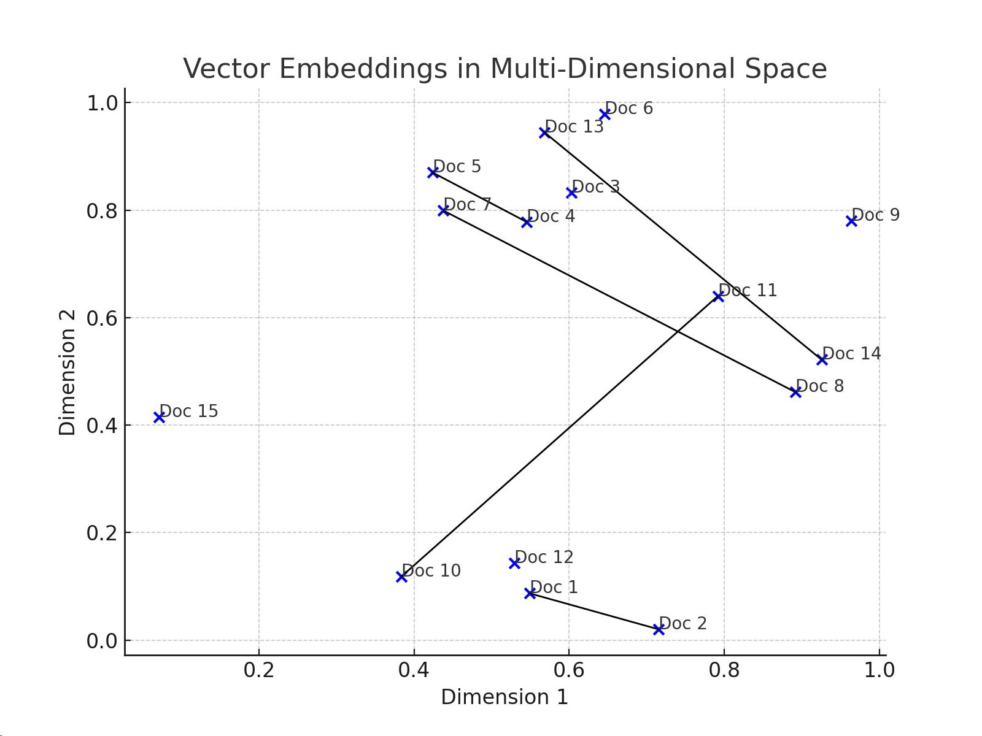
Using Vectors and embeddings
About Tigers
Embeddings convert text to coordinates that maintain relative distances between text that have similar meanings.
About Bears
© 2025 Microsoft. All rights reserved.
Notes:
<Coach>
Vectors are arrays of floating-point numbers stored in PostgreSQL using the pgvector extension. They enable efficient similarity searches, allowing AI applications to retrieve contextually relevant data.

Slide 22
Using Vectors and embeddings
About Tigers
Embeddings convert text to coordinates that maintain relative distances between text that have similar meanings.
About Bears
© 2025 Microsoft. All rights reserved.
Notes:
<Coach>
Vectors are arrays of floating-point numbers stored in PostgreSQL using the pgvector extension. They enable efficient similarity searches, allowing AI applications to retrieve contextually relevant data.

Slide 23
Indexing for vectors
IVFFlat
(Inverted File Index)
Partitions vectors into clusters and assigns each vector to one cluster.
Building the index is fast and memory-efficient
Requires a separate clustering step before indexing (slow)
Tuning parameters is important. Can be very accurate if configured properly
HNSW
(Hierarchical Navigable Small World))
Builds a multi-layer graph with long and short connections between the vectors.
Robust and accurate at scale
No-preprocessing step.
Can support many inserts/deletes efficiently.
Larger memory footprint
It also has many parameters (such as the number of layers and neighbors) that need to be tuned carefully.
DiskANN
(Disk-based Approximate Nearest Neighbor) )
Graph-based indexing method optimized for disk storage.
Unlike IVFFlat and HNSW, DiskANN stores most of its data on disk, making it ideal for large-scale vector search.
Highly scalable for billion-scale vector datasets.
Optimized for SSDs, enabling fast retrieval with minimal memory footprint
© 2025 Microsoft. All rights reserved.
Notes:
<Coach>
We use vector indexes when:
You have structured or semi-structured operational data (e.g. chat history, customer profiles, business transactions etc.) in a database.
Simplified architecture for single source of truth combining vector similarity search inline with database queries. No need to synchronize separated database and vector index.
The workload benefits from mission-critical OLTP database characteristics (e.g. stronger guarantees for availability and performance).
Vector indexing is a critical pattern when building an AI application, as you can perform Approximate Nearest Neighbor similarity searches and fetch the relevant data in order to make sure you don't exceed your token limit.
These vector indexes are built into the database, the indexes that are supported today are:
IVF is a partition-based indexing strategy.
Whereas HNSW is a graph-based indexing approach.
EMPHASIS THAT PostgreSQL has DiskANN SUPPORT NOW
- DiskANN is a technology used to efficiently search and retrieve similar data points from large datasets. DiskANN combines an in-memory index of compressed vectors with a full-fidelity graph stored on fast SSDs (Solid State Drives). This setup allows for quick access to data with low latency and high accuracy, even when dealing with very large datasets.
DiskANN means that PostgreSQL can store, index, and query different types of data (like text, images, etc.) and use DiskANN to quickly find and retrieve similar data points. This integration enhances the database's performance, scalability, and consistency, making it suitable for applications in AI, such as natural language processing, image recognition, and recommendation systems
Comparisons: - IVFFlat: Fast indexing, efficient memory use, but requires pre-clustering.
- HNSW: Highly accurate, fast lookups, but memory-intensive.
- DiskANN: Disk-based storage, balances speed, scalability, and memory usage..

Slide 24
When to use IVFFlat, HNSW or DiskANN?
IVFFlat
More suitable for scenarios where vectors have low to medium dimensions (e.g., less than 100), and the similarity metric is Euclidean distance or cosine similarity.
More suitable for resource constrained systems as memory usage can be at least half that of HNSW.
HNSW
More suitable for scenarios where vectors have high dimensions (e.g., more than 100), and the similarity metric is inner product or angular distance.
HNSW indexes can be created immediately after table creation.
Excellent performance for use cases with up to 2,000 dimensions.
DiskANN )
This preview feature is only available for newly deployed Azure Database for PostgreSQL flexible server instances.
Enhances AI-driven responses by retrieving relevant context efficiently
Excellent performance for vectors exceeding 2,000 dimensions.
© 2025 Microsoft. All rights reserved.
Notes:
<coach> Scalability: DiskANN can efficiently handle millions to billions of vectors, even with high-dimensional embeddings.
Dimensionality Support: Unlike HNSW, which performs well up to 2,000 dimensions, DiskANN is optimized for handling much higher-dimensional vectors efficiently.
Use Cases: Commonly used in large-scale AI applications, including search engines, recommendation systems, and NLP, where embeddings often exceed 2,000 dimensions.

Slide 25

Retrieval Augmented Generation (RAG)
Retrieval Augmented Generation (RAG) intelligently retrieves a subset of data from data stores to provide specific, contextual knowledge to the large language model to support how it answers a user’s prompt.
Notes:
- RAG: Retrieval Augmented Generation, a fancy term that essentially means retrieving additional data from database to provide to a LLM, like OpenAI’s ChatGPT, to use when generating a response (completion) to a user’s question (prompt).
- This approach allows your LLM to generate contextually relevant responses based on your custom data sourced from vectorized docs, images, audio, video etc.

Slide 26
Anatomy of RAG
User Question
Orchestrator
Query My Data
Search Index
Add Results to Prompt
Query Model
Large Language Model
Send Results
Notes:
30 seconds
Speaker notes
RAG combines retrieval-based and generation-based models to provide more accurate and contextually relevant responses. The retriever fetches relevant documents or information from a large corpus, which are then used to augment the generation process. This approach enhances the quality of the generated responses by grounding them in factual and relevant information.

Slide 27
Brief history of AI
Artificial Intelligence
Artificial Intelligence
The field of computer science that seeks to create intelligent machines that can replicate or exceed human intelligence.
1956
Machine Learning
Machine Learning
Subset of AI that enables machines to learn from existing data and improve upon that data to make decisions or predictions.
1997
Deep Learning
Deep Learning
A machine learning technique in which layers of neural networks are used to process data and make decisions.
2012
Generative AI
Generative AI
Create new written, visual, and auditory content given prompts or existing data.
2021
Notes:
Coach guidance
This slide has ANIMATION that helps build this story. Do not spend much time on the history. It is to give them a perspective of the evolution of Generative AI.
Speaker notes
What is Generative AI and where does it fit into the scope of AI?
Generative AI is a subfield of Artificial Intelligence that focuses on creating systems that can generate new examples, such as images, text, or speech, that are similar to examples from a given dataset. The goal of generative AI is to develop algorithms that can learn the underlying probability distribution of a given dataset and use this knowledge to generate new examples that are similar to the examples in the dataset.
Generative AI models can be classified into two broad categories: generative models and discriminative models. Generative models such as GPT-3, DALL-E, Variational Autoencoders etc. learns the underlying probability distribution of the dataset and can generate new examples from the learned distribution. Discriminative models, such as deep neural networks, learn to differentiate between different classes or categories, and are generally used for tasks such as image or speech recognition.
Generative AI sits on top of other areas of AI like unsupervised learning, supervised learning and reinforcement learning. It relies on the capability of those models to extract useful features from the data and use that for learning the underlying probability distribution of the data which is used for generthe potential to be used in a wide range of applications, such as computer vision, natural language processing, speech recognition, and many more.

Slide 28
Azure OpenAI
The Azure OpenAI Service:
provides REST API access to OpenAI's powerful language models including the GPT-4, GPT-4 Turbo with Vision, GPT-3.5-Turbo, and Embeddings model series, which can be easily adapted to your specific task.
gives customers advanced language AI with OpenAI GPT-4, GPT-3, Codex, DALL-E, and Whisper models with the security and enterprise promise of Azure.
co-develops the APIs with OpenAI, ensuring compatibility and a smooth transition from one to the other.
Notes:
30 seconds
Coach guidance
Speaker notes
The Azure OpenAI Service:
provides REST API access to OpenAI's powerful language models including the GPT-4, GPT-4 Turbo with Vision, GPT-3.5-Turbo, and Embeddings model series.
These models can be easily adapted to your specific task including but not limited to content generation, summarization, image understanding, semantic search, and natural language to code translation. Users can access the service through REST APIs, Python SDK, or our web-based interface in the Azure OpenAI Studio.
gives customers advanced language AI with OpenAI GPT-4, GPT-3, Codex, DALL-E, and Whisper models with the security and enterprise promise of Azure. Azure OpenAI co-develops the APIs with OpenAI, ensuring compatibility and a smooth transition from one to the other.
Source: What is Azure OpenAI Service? - Azure AI services | Microsoft Learn - https://learn.microsoft.com/en-us/azure/ai-services/openai/overview

Slide 29
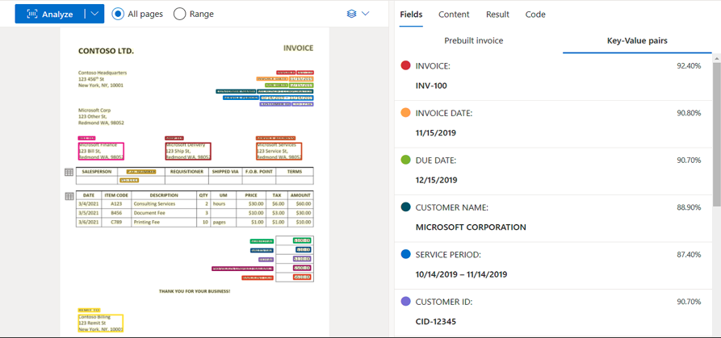
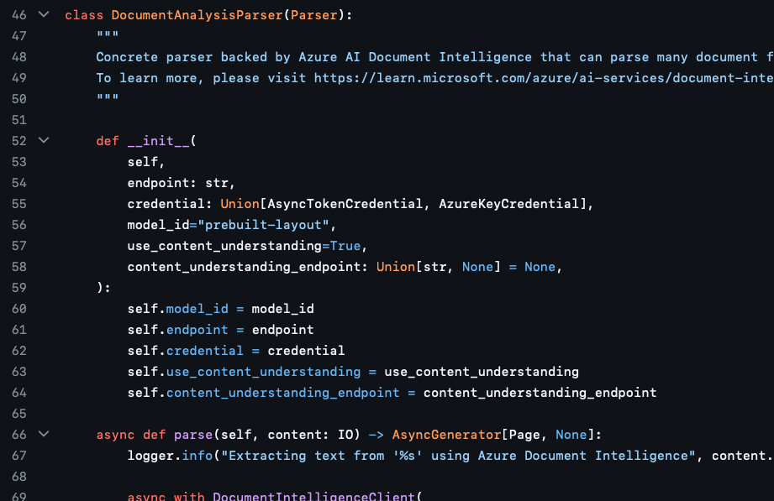
Document Intelligence
Automated Data Extraction:
Utilizes AI to extract text, key-value pairs, and tables from various document types, transforming unstructured data into structured formats.
Prebuilt and Custom Models:
Offers prebuilt models for common documents like invoices and receipts, as well as customizable models tailored to specific business needs.
Integration with Business Processes:
Seamlessly integrates extracted data into workflows, enhancing efficiency in operations such as contract management and financial document processing.
Notes:
<coach> Document Intelligence is a cloud-based AI service that automates the extraction of information from diverse documents. By leveraging advanced machine learning, it can accurately identify and pull out text, key-value pairs, and tables, converting unstructured data into structured, actionable insights. This capability is particularly beneficial for organizations dealing with large volumes of documents, as it reduces manual data entry and minimizes errors.
The service provides both prebuilt models and the flexibility to create custom models. Prebuilt models are designed for standard document types such as invoices, receipts, and contracts, enabling quick deployment.
Custom models can be trained to meet particular business needs for documents with unique formats or specific data requirements, ensuring accurate data extraction tailored to organizational processes.
Integrating Document Intelligence into business workflows streamlines operations by automating data processing tasks. For instance, in contract management, the service can extract pertinent details from agreements, facilitating efficient tracking and analysis. Similarly, in financial operations, it can process invoices and receipts swiftly, ensuring timely and accurate data entry into accounting systems. This integration not only enhances operational efficiency but also supports informed decision-making by providing reliable data insights.
In the solution accelerator – we are interacting with Document intelligence via python code

Slide 30
Azure Machine Learning (ML)
Semantic Ranking for Improved Relevance:
Machine learning models can be employed to re-rank search results, ensuring the most contextually relevant information is prioritized.
Integration of Semantic Ranker Models in PostgreSQL:
PostgreSQL's capabilities are used to invoke semantic ranker models directly within SQL queries, enhancing data retrieval accuracy.
User-Defined Functions (UDFs) for Model Inference:
UDFs are used to seamlessly call Azure Machine Learning endpoints, facilitating efficient semantic ranking within the database.
Notes:
<coach> To improve Retrieval-Augmented Generation (RAG) accuracy, we use semantic ranking, which employs machine learning to reorder search results based on contextual relevance. Unlike traditional keyword searches, semantic ranking ensures AI retrieves the most meaningful information.
By leveraging the azure_ai extension in PostgreSQL, we can integrate semantic ranker models directly into SQL queries. This real-time re-ranking streamlines retrieval, reduces external processing, and enhances query accuracy.
To achieve this, we use User-Defined Functions (UDFs) that call Azure Machine Learning endpoints, passing query data to AI models for relevance scoring. These managed online endpoints provide scalable, secure, real-time inference, ensuring low-latency performance even with high query volumes.
By combining PostgreSQL, Azure ML, and semantic ranking, we enhance precision, efficiency, and reliability in AI-driven applications.

Slide 31







Azure AI Studio
Build and train your own models
Ground Azure OpenAI Service and OSS models using your data
Built-in vector indexing
Retrieval augmented generation made easy
Create prompt flows
AI safety built in
31
Notes:
<coach>
Azure AI Studio enables teams to collaborate efficiently and effectively on AI projects, such as developing custom copilot applications that use large language models (LLMs). Tasks you can accomplish with Azure AI Studio include:
Deploying models from the model catalog to real-time inferencing endpoints for client applications to consume.
Deploying and testing generative AI models in an Azure OpenAI service.
Integrating data from custom data sources to support a retrieval augmented generation (RAG) approach to prompt engineering for generative AI models.
Using prompt flow to define workflows that integrate models, prompts, and custom processing.
Integrating content safety filters into a generative AI solution to mitigate potential harms.
Extending a generative AI solution with multiple AI capabilities using Azure AI services.

Slide 32
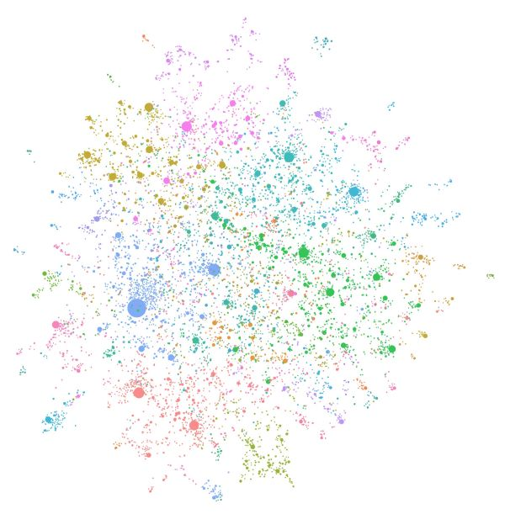
Enhancing Retrieval Augmented Generation (RAG) with GraphRAG
What is GraphRAG?:
An advanced Retrieval Augmented Generation (RAG) method integrating graph databases.
Enhances context retrieval by structuring relationships between knowledge entities.
How GraphRAG Improves AI Copilots:
Better Context Awareness: Links related entities for more accurate responses.
Improved Semantic Search: Uses graph embeddings and relationships to refine results.
Scalability: Handles large knowledge bases efficiently.
Implementation with PostgreSQL:
Uses Azure Database for PostgreSQL + pgvector for vector search.
Graph-based entity linking for financial services, fraud detection, and document validation.
Seamlessly integrates into existing AI pipelines.
32
Notes:
<coach>
If time is limited – just read the Key Benefits at the bottom
Introduction to GraphRAG
Traditional RAG systems retrieve information based on keyword or vector similarity.
GraphRAG enhances this process by mapping relationships between data points, improving AI-driven retrieval.
This is especially useful when dealing with complex, interconnected knowledge, like legal documents or financial contracts.
Why is GraphRAG Better?
Instead of relying on isolated vector embeddings, GraphRAG connects relevant concepts.
Example: If a user asks about a financial regulation, GraphRAG can trace related laws, previous cases, and relevant clauses.
GraphRAG in Action with PostgreSQL
Uses pgvector for embedding-based search.
PostgreSQL supports graph extensions that can map entity relationships.
This makes it a great fit for AI copilots handling financial document validation.
Real-World Use Case
In a financial setting, GraphRAG can improve contract validation by linking invoices to SOWs and past transactions.
This reduces errors and provides auditors with a knowledge graph of interrelated financial data.
Key Benefits
Structured knowledge representation for better contextual retrieval.
Reduces hallucinations by linking related data.
More relevant responses through semantic reasoning.

Slide 33
Exercise one - lab setup
Exercise Scenario
In this exercise, you will deploy the required Azure resources, including an Azure Database for PostgreSQL - Flexible Server, to support the application's backend.
Install Required Software
Set up the development environment by installing tools such as Azure CLI, Git, Python 3.11+, Node.js, Docker Desktop, Visual Studio Code (with relevant extensions), and pgAdmin.
Fork and Clone the Repository:
Create a personal fork of the PostgreSQL Solution Accelerator repository and clone it to your local machine to customize and build upon the existing codebase.
Configure the Development Environment:
Establish a Python virtual environment, install required Python libraries, create and populate a .env file with necessary configurations, and connect to the PostgreSQL database using pgAdmin.
© 2025 Microsoft. All rights reserved.
Notes:
<coach>: In this session, we'll focus on laying the groundwork for our AI Copilot application by setting up the necessary infrastructure and development environment. First, we'll provision the essential Azure resources, including deploying an Azure Database for PostgreSQL - Flexible Server, which will serve as the backbone of our application's data storage and management. Next, we'll install a suite of required software tools to facilitate our development process. These tools include the Azure CLI for managing Azure resources from the command line, Git for version control, Python 3.11+ for our backend development, Node.js for any JavaScript runtime needs, Docker Desktop for containerization, Visual Studio Code along with pertinent extensions for code editing, and pgAdmin for database management. Following the installation, we'll proceed to fork the PostgreSQL Solution Accelerator repository to our personal GitHub accounts and clone it locally. This step allows us to have a working copy of the codebase that we can modify and enhance. Finally, we'll configure our development environment by creating a Python virtual environment to manage dependencies, installing the necessary Python libraries as specified in the requirements.txt file, setting up a .env file with all required environment variables, and connecting to our PostgreSQL database using pgAdmin. Completing these tasks will ensure that we have a robust and ready-to-use environment for developing and integrating the AI capabilities into our application in the upcoming sessions.

Slide 34
Thank you

